Slide 1


Building Bridges: Empowering Students through Community Volunteer Matching for BEEE Projects

Slide 2

Challenges Faced by Students
Students often encounter challenges when trying to ﬁnd suitable community projects for their BEEE initiatives. and spare parts for their projects. These project requirements are common issues. These challenges
delays students project..

Slide 3

Benefits of Volunteer Matching
Volunteer matching platforms offer a solution to the challenges faced by students. These platforms connect students with suitable community projects based on their interests, skills, and availability. By utilizing volunteer matching, students can maximize their impact, gain valuable experience, and create meaningful connections within the community.

Slide 4
techstacks
Frontend: HTML/CSS, JavaScript, GSAP Backend: Node.js,
Database: MongoDB,

Slide 5

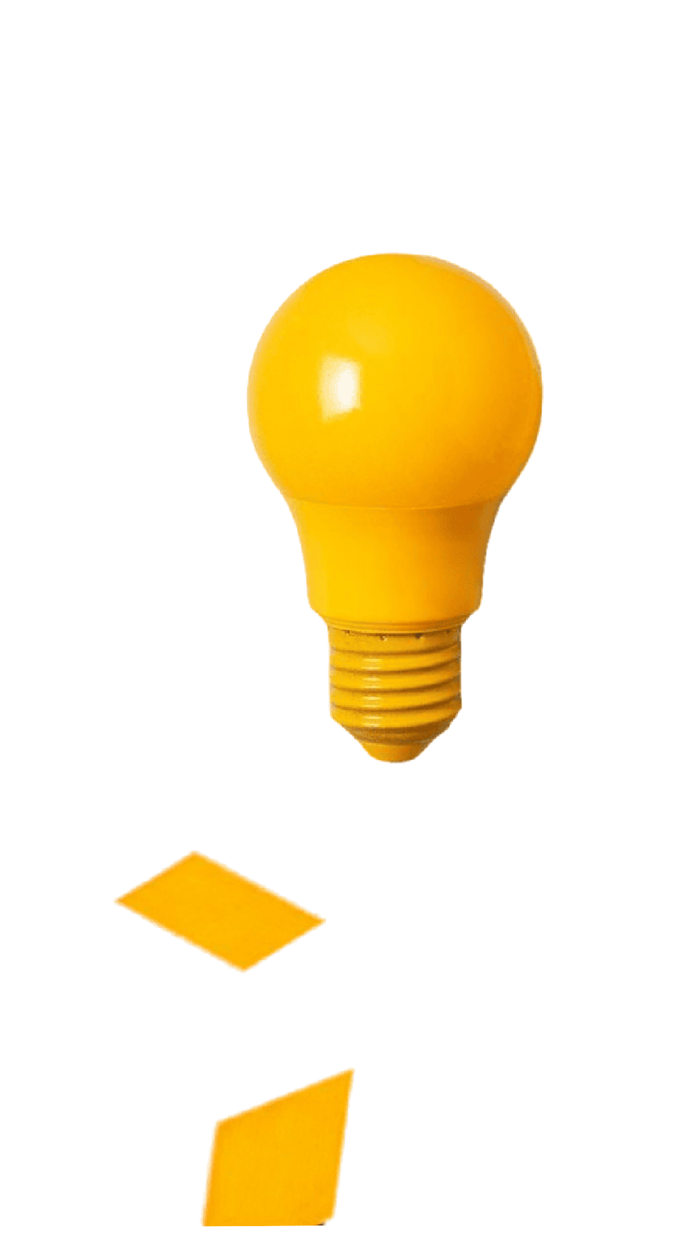
how is the idea unique?
The idea for a community volunteer matching platform for BEEE (Bachelor of Electrical and Electronics Engineering) students is unique because it focuses on a niche educational ﬁeld, fostering collaboration, mentorship, and resource-sharing speciﬁc to BEEE projects. It addresses the specialized needs of these students and has the potential to positively impact their education and career prospects.

Slide 6
Architecture of idea.
Frontend: User interface for students and volunteers to create proﬁles, search for projects, and communicate.
Backend: Manages user data, project listings, and messaging. Implements matching algorithms and handles user authentication.
Database: Stores user proﬁles, project details, messages, and resource repository data.

Slide 7
Thanks!
Do you have any questions?

